Slide 1
SMART AGRICULTURE SYSTEM
Created by
Raja M
Reg.no.: 912321104034
3rd year cse
SACS MAVMM Engineering college
Madurai

Slide 2
Project Outline
Problem statement
Proposed system /solution
System development approach
Algorithm and deployment
Result
Conclusion

Slide 3
Problem statement
To provide efficient decision web using wireless sensor network which handle different activities of farm and provides useful information associated with farm. Information associated with Soil moisture, Temperature and Humidity content.Due to the atmospheric condition, water level increasing Farmers get lot of distractions which isn't good for Agriculture. Water level is managed by farmers in both Automatic/Manual using that mobile application. it'll make easier to farmers. Performing agriculture is incredibly much time consuming.

Slide 4
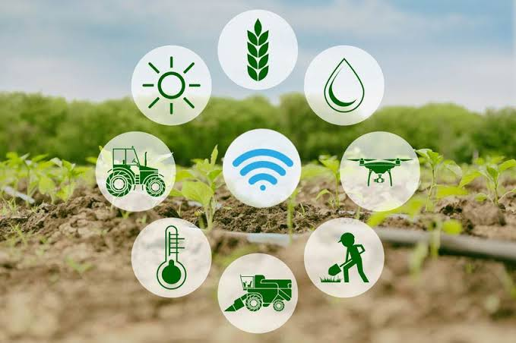
Welcome to Smart Agriculture System

Slide 5
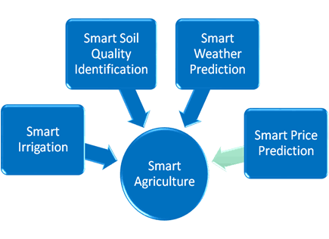
Types of Smart Agriculture System
Smart agriculture systems encompass various technologies and approaches aimed at enhancing efficiency, productivity, and sustainability in farming practices. Some types of smart agriculture systems include:

Slide 6
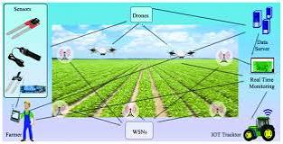
PROPOSEDSYSTEM(Contd…) A proposed smart agriculture system could integrate several innovative solutions to address various challenges faced by farmers and enhance overall agricultural productivity. Here's a detailed outline of such a system:

Slide 7
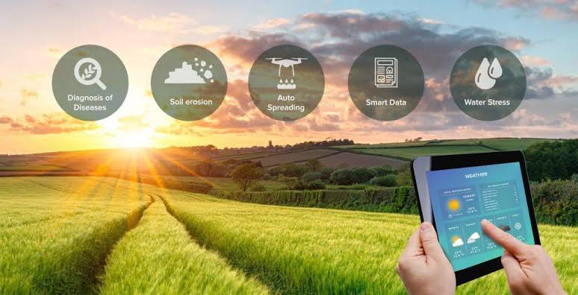
Pproposed System(Contd..)
proposed system focuses on automatic irrigation of water and plant disease detection. It uses machine learning algorithms to accurately predict adequate water required by the fields and automatic pest identification based on the requirements of the farmland.

Slide 8
Proposed system solution
proposed system solution for a smart agriculture system could include components like sensors for monitoring soil moisture, temperature, and nutrient levels, along with actuators for automated irrigation and fertilization. Data collected by the sensors can be sent to a central hub or cloud platform for analysis, where algorithms can provide insights and recommendations to farmers via a user-friendly interface, such as a mobile app or web dashboard. This simplified system aims to streamline farm management tasks, optimize resource usage, and increase crop yields.

Slide 9
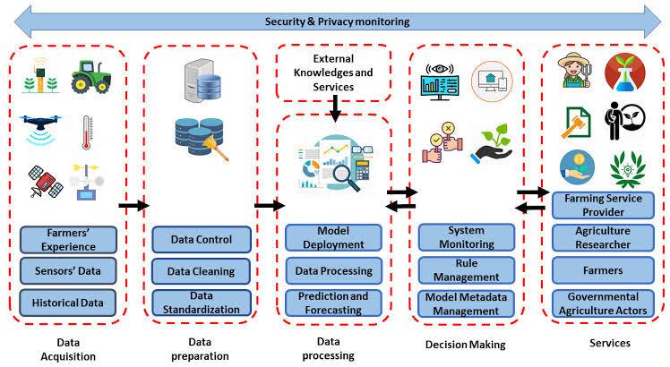
System development approach
Thus the concept of Farming System Approach can be summarized as it is a holistic approach, complex in nature, interrelated of components, matrix of soils, plants, animals, power, implements, labour, capital and other inputs, influenced by political, economic, institutional and social forces.

Slide 10
Algorithm and deployment (contd..)
1.Data Collection: Gather data from sensors monitoring soil moisture, temperature, humidity, and other relevant factors.
2.Data Processing: Analyze collected data to assess the current condition of the farm, identify trends, and predict future conditions.
3.Decision Making: Based on the analyzed data, make decisions such as when to irrigate, fertilize, or apply pesticides.
4.Actionable Insights: Provide farmers with actionable insights and recommendations through a user-friendly interface, such as a mobile app or web dashboard.

Slide 11
Algorithm and deployment(contd..)
Hardware Installation: Install sensors and actuators in strategic locations across the farm to collect data and perform automated actions.
Networking: Set up a network infrastructure, such as Wi-Fi or LoRaWAN, to facilitate communication between sensors, actuators, and the central processing unit.
Centralized Processing: Establish a centralized processing unit, either on-site or in the cloud, to collect and analyze data from sensors.
User Interface: Develop a user-friendly interface for farmers to access real-time data, receive notifications, and make informed decisions.
Testing: Conduct thorough testing of the system in a controlled environment before deploying it on the farm to ensure reliability and accuracy.
Deployment: Deploy the system on the farm, ensuring proper calibration of sensors and actuators, and providing training to farmers on how to use the system effectively.
Monitoring and Maintenance: Regularly monitor the system's performance and provide ongoing maintenance and support to address any issues that arise.

Slide 12
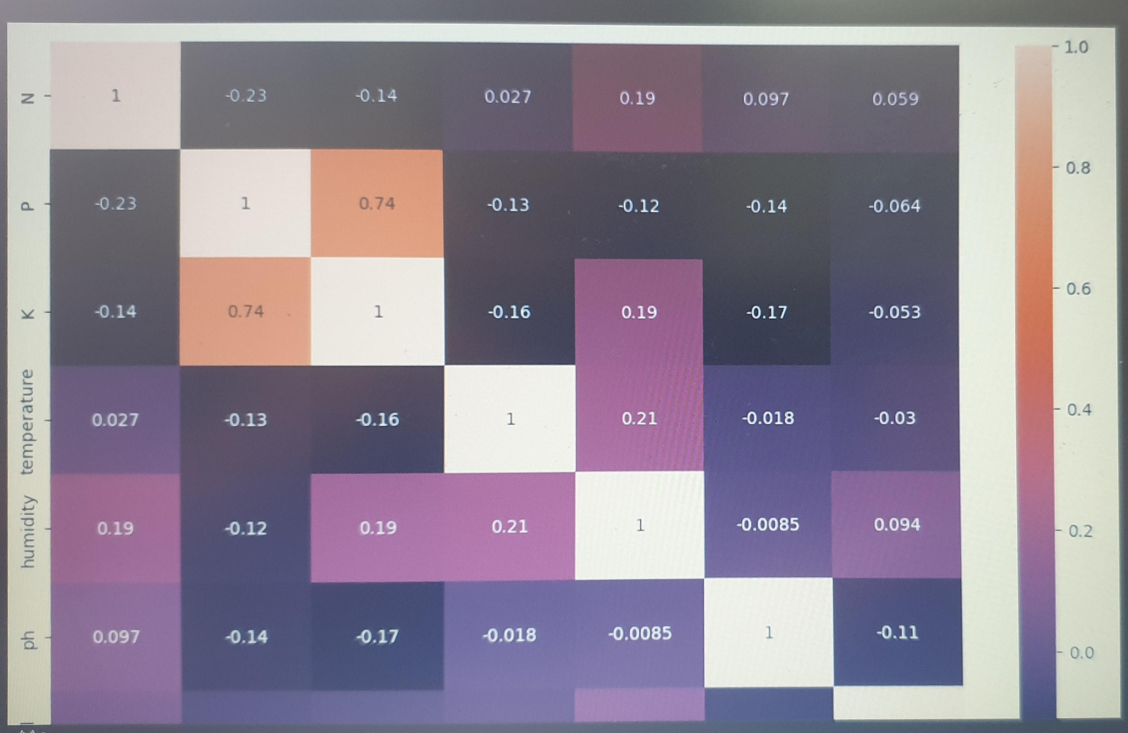
Result
Improved product quality helps to improve farm income and provides financial support for the adoption of green production technologies.

Slide 13
REFERENCE
https://www.smartfarm.ag/about-us/the-problem-to-be-solved/
https://aimlprogramming.com/services/smart-farming-data-collection-automation/
https://www.sciencedirect.com/science/article/pii/S1110982321000582
https://www.kaggle.com/datasets/chitrakumari25/smart-agricultural-production-optimizing-engine
https://colab.research.google.com/drive/1ZoCNPIfg_CFf48EztVgvAINDlZWO5sD7

Slide 14
Conclusion
In conclusion, using cutting-edge technology like IoT, AI, and automation, smart farming represents a revolutionary approach to agriculture. Farmers can optimize resource use, boost productivity, and lessen their impact on the environment by utilizing real-time data and data-driven insights.

